Slide 1

Technology Solutions Department
GIS Division
Proposed Budget
FY 2016
March 30, 2015

Slide 2
Technology Solutions
Geographic Information Systems
(FY15:8.25 FTEs)
CIO/Director
Technology Solutions Department
(.25 FTE)
GIS Manager
System & Database administration
(1 FTE)
GIS Analyst II
Planning support
(1 FTE)
GIS Analyst II
Internet application development
(1 FTE)
GIS Analyst II
Database development
(1 FTE)
GIS Analyst II
Customized mapping
(1 FTE)
GIS Analyst II
Internet application/digital orthophotography
(1 FTE)
Address Coordinator
Paid Partial by 911
(1 FTE)
GIS Analyst
911 service support
Paid Partial by 911
(1 FTE)

Slide 3
FTE Reconciliation
Total FTEs:
1. Currently Filled: 8
2. Vacant: 0
3. Unfunded: 0
4. Grant Funded: 0
5. Vacant Grant Funded: 0
Total FTEs: 8

Slide 4
FY15 Budget Status
The GIS Division expects to be at budget
78.0% of the general fund budget expended
  Expenditures
  69.4% - Personal Services
  96.9% - Operating Expenses
  As of February 28, 2015
Notes:
Be prepared to discuss your YTD and EOY numbers for Revenues, and Expenditures
Date of report for percentages February 28, 2014

Slide 5
FY15 New Initiatives Update
GIS Improvements – License and GoMaps Upgrade
  Complete
Notes:
Be prepared to discuss your YTD and EOY numbers for Revenues, and Expenditures
Date of report for percentages March 28, 2012

Slide 6
Key Issues
Increased demand for 3D imagery and analysis (Addressed in FY16 through new budget initiative)

Slide 7
Budget Summary
FY2014-2015 FY2015-2016
Personal Services $700,628 $715,902
Operating Costs $137,000 $133,200
Capital Outlay $0.00 $0.00
Total $837,628 $849,102
City Budget $421,314 $422,051
County Budget $421,314 $422,051
Notes:
The increase in the budget is due to salary increases. City/County Portion is after GIS data sales offset of 5,000.

Slide 8
FY16 Initiatives
GIS 3D Modeling for Urban Design - $13,960
Pilot new capability for 3D visualization and analysis
Recurring cost - $675
Notes:
Includes ESRI 1 CityEngine license and 1 workstation. Important tool to support form based planning.

Slide 9
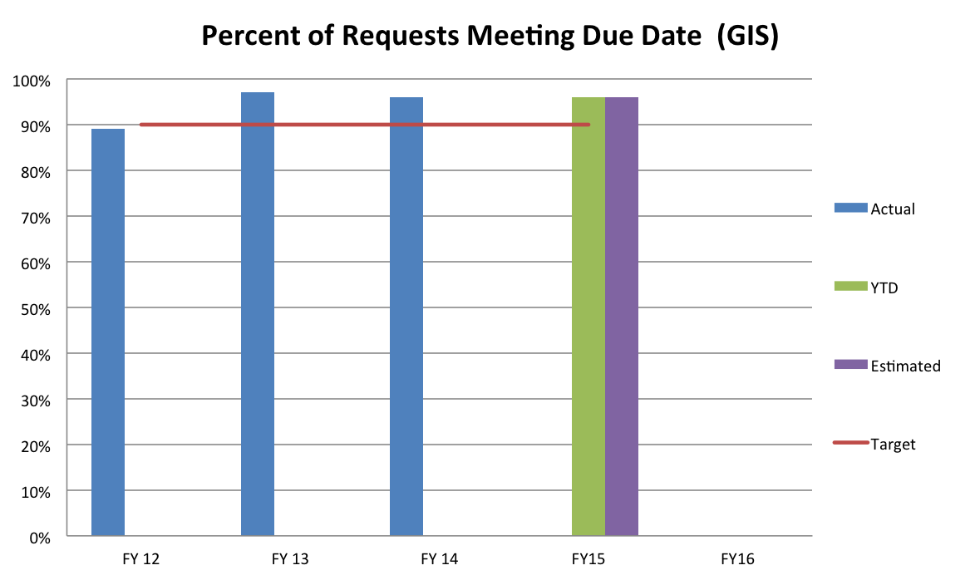
FY13 Programs and Measures
July 1st – February 28th
Notes:
These should be same programs / measures shown in your budget submittal. Please provide a description of your EOY projection, and be prepared to discuss. Example: “on target” “we are expecting to be under target, and are therefore be requesting more resources”…. Anything relevant to the discussion of “what is going on with your EOY and why”

Slide 10
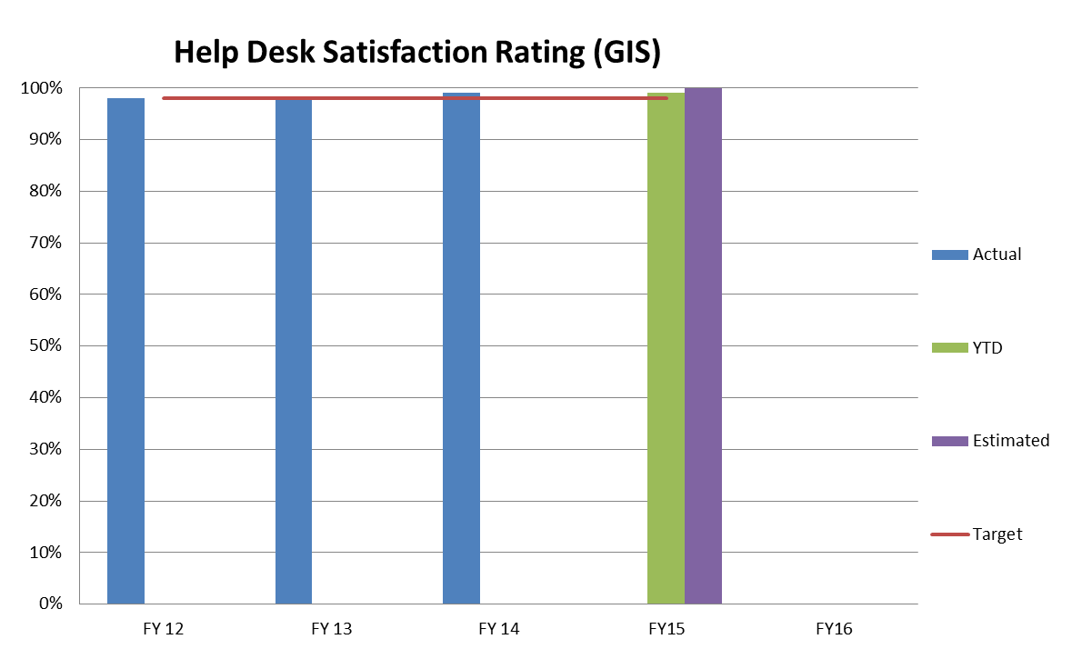
FY13 Programs and Measures
July 1st – February 28th
Notes:
These should be same programs / measures shown in your budget submittal. Please provide a description of your EOY projection, and be prepared to discuss. Example: “on target” “we are expecting to be under target, and are therefore be requesting more resources”…. Anything relevant to the discussion of “what is going on with your EOY and why”

Slide 11
FY13 Programs and Measures
July 1st – February 28th
Future GIS Performance Measures
Web GIS - Number of hits, Google Analytics, etc.
Time it takes a request to be assigned to a resource for completion
Percent of requests meeting due dates broken down by type of work classification
Innovations survey - percent of business units utilizing GIS (management) rating GIS innovations good to excellent

